Slide 1
JIO vs Other Telecom Networks – A Comparative Analysis Using YouTube and Twitter Network Data

Slide 2





Meet Our Team
Arumugam Sathiavakeeswaran
Miles Eckles
Preethy Thomas
Shreyas Chandran
Sridhar Srinivasan

Slide 3




Agenda
INTRODUCTION
Twitter Analysis
JIO Story Till Date
Current News On JIO
JIO State wise Sentiment Analysis Post IPL Campaign Introduction
Pre and Post Sentiment Analysis In Tableau
Jio overall network analysis
Vodafone overall network analysis
You Tube Analysis
Overall Network Analysis
You Tube Analysis For Jio IPL Campaigns
You Tube Analysis For Vodafone IPL Campaigns
Conclusions
Key Takeaways

Slide 4
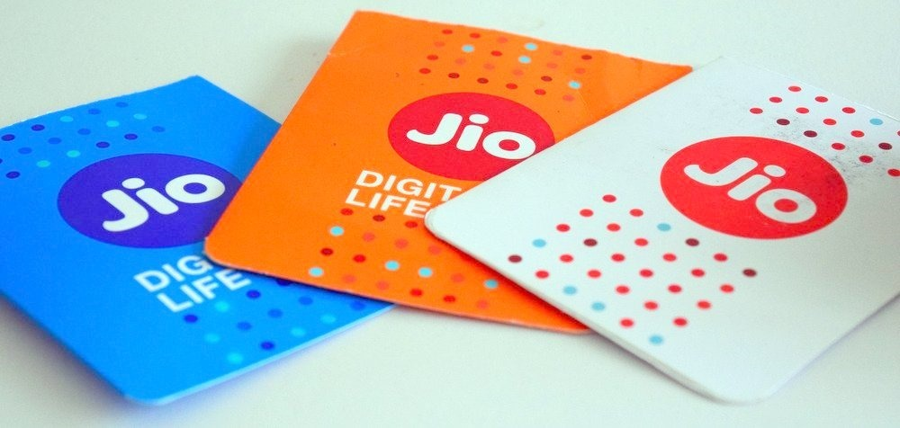
1
Introduction

Slide 5
JIO Story Till Date
01
Introduction of Reliance Jio to Indian market
02
Impact on Twitter
03
State wise analysis
04
Overall negative sentiments

Slide 6
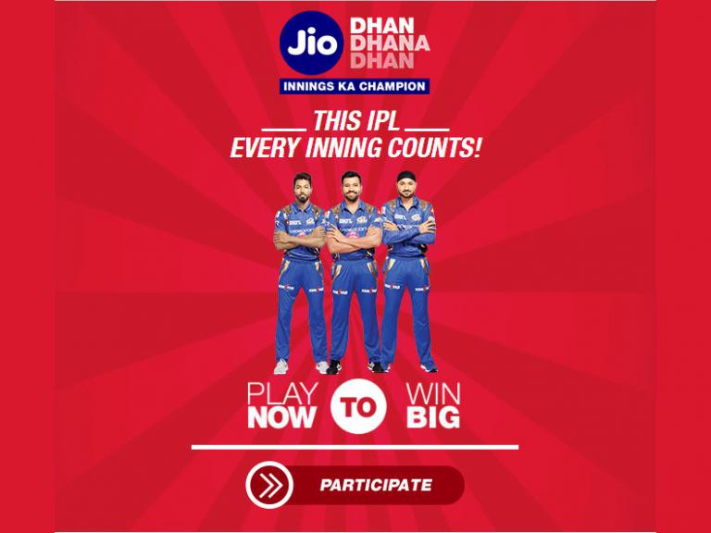
Current News On JIO
01
Closure of JIO Summer Surprise Offer
As per TRAI order, JIO closes the Summer-Surprise offer midway
02
JIO IPL
Reliance JIO sponsors seven IPL teams playing this season barring Kings XI Punjab
03
JIO Dhan Dhana Dhan Offer
New offer introduced by JIO for its customers on the wake of IPL season
04
Speed Increase To 100 MBPS
JIO FTTH Broadband Service to come up with 100 MBPS speed in June

Slide 7


2
You Tube Network Analysis

Slide 8
You Tube Network Video Density Comparison
Collected YouTube shared video category data for Jio, Airtel, Vodafone, Aircel and BSNL
Classified videos into network providers and performed comparison analysis
Visualized the graph density for each of the clusters

Slide 9
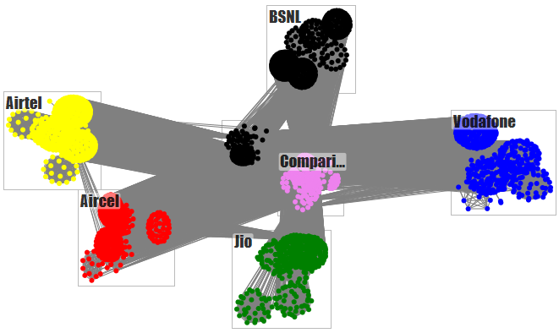
You Tube Network Video Density Comparison

Slide 10
Jio IPL Campaign You Tube Network Analysis
Collected YouTube shared video category data for Jio IPL campaign as they sponsor seven of the eight IPL teams
Classified the videos as Jio and competitors
Visualized the graph density for each of the clusters

Slide 11
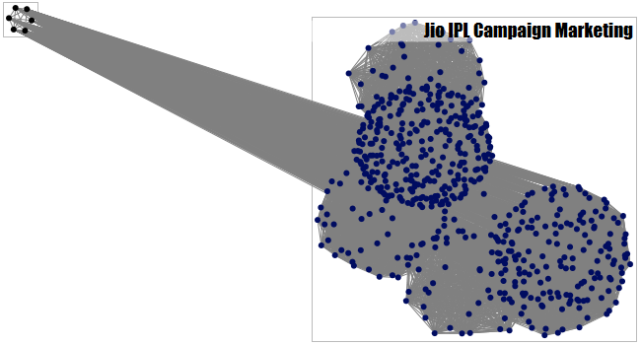
Jio IPL Campaign You Tube Network Analysis

Slide 12
Vodafone IPL Campaign You Tube Network Analysis
Collected YouTube shared video category data for Vodafone IPL campaign as they are associate Title Sponsor
Classified the videos as Vodafone and competitors
Visualized the graph density for each of the clusters

Slide 13
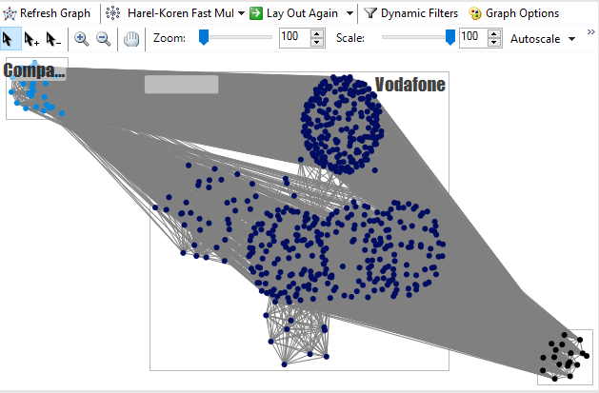
Vodafone IPL Campaign You Tube Network Analysis

Slide 14

3
Twitter Analysis

Slide 15
JIO state wise Sentiment Analysis Post IPL Campaign Introduction
Collected state wise data from Twitter for Jio DhanDhanaDhan Campaign
Categorized data into state and further region and performed sentiment analysis
Results indicative of an overall positive trend post the IPL campaign

Slide 16
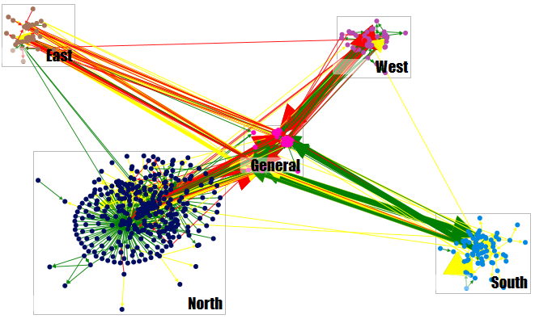
JIO state wise Sentiment Analysis Post IPL Campaign Introduction

Slide 17
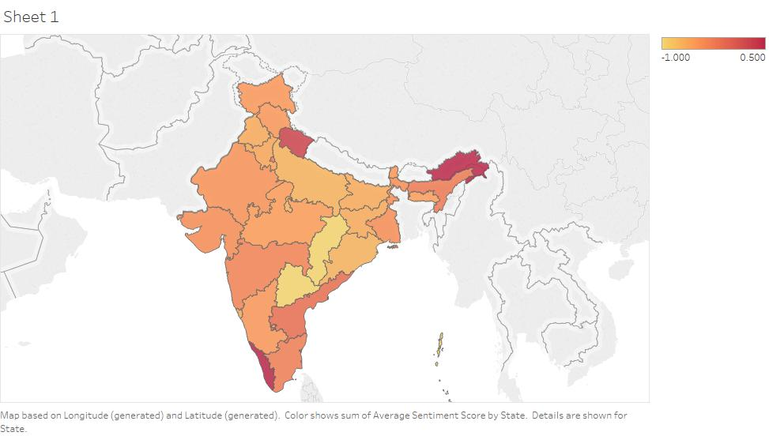
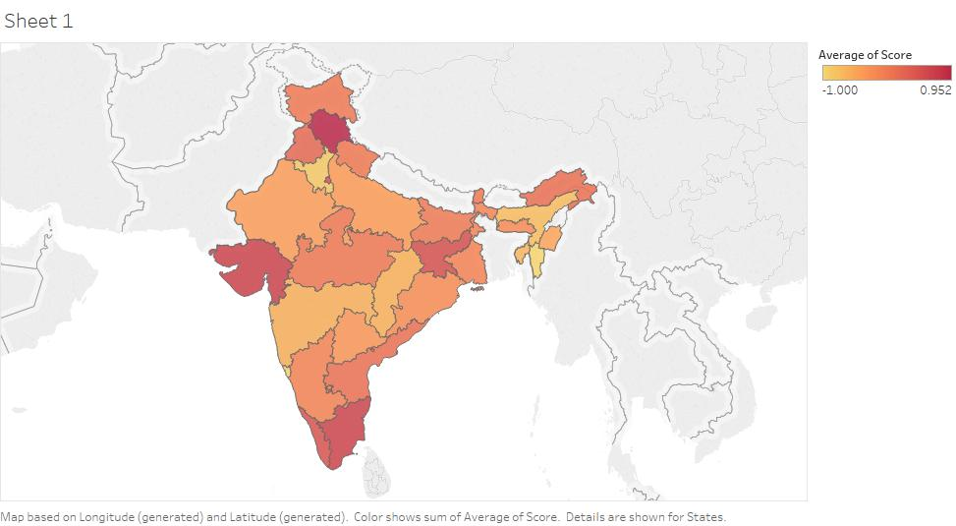
JIO state wise Sentiment Analysis Pre and Post IPL Campaign
Pre IPL
Post IPL

Slide 18
JIO Overall Network Sentiments
Collected Twitter data for Jio
Performed sentiment analysis and categorized tweets into positive, negative and neutral sentiments
Visualized based on sentiment grouping

Slide 19
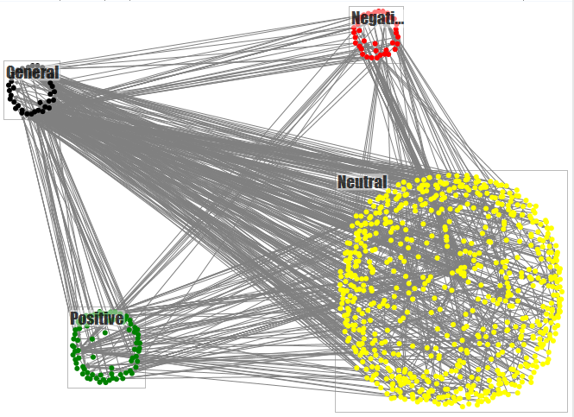
JIO Overall Network Sentiments

Slide 20
Vodafone Overall Network Analysis
Collected data for Vodafone from Twitter
Visualized the data
Results indicative of a perfect Hub and Spoke model with Vodafone being the center implying higher tweet rate to the Vodafone handle with not many replies

Slide 21
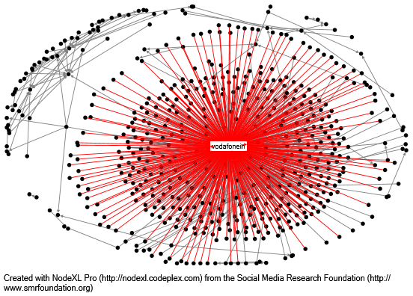
Vodafone Overall Network Analysis

Slide 22

4
Conclusion

Slide 23
Key Takeaways
Ambush Marketing with IPL
Vodafone – Under utilized marketing
Idea4G - Dormant
Major Telecom players using IPL as a platform for extensive marketing
Vodafone failing to capture Twitter and You Tube even though it has a natural organic market considering their nine year association with IPL
Though Idea4G is a sponsoring one of the teams in IPL, their Twitter and You Tube marketing strategy is almost null
Jio – Marketing Leaders
Mood Swings for Jio Users
Jio moving towards a better future
Though being only a few months old, they are sponsoring 7 of the eight teams in IPL. Their social media marketing strategy is extensive and in tandem with the other modes of marketing
Post the IPL marketing, we see a conclusive positive sentiment by the Jio users as against our earlier findings over the Twitter and You Tube network
Considering the current pattern, it is evident that Jio is moving towards a better future and at this pace, they will indeed beat the current market leaders soon

Slide 24
Thank you!
Any questions?

